Slide 1




PROJECT CODENAME
Hummingbird
OBJECT-MODEL BASED TEST SOLUTION
© 2013-2018 Huaxing YUAN, This presentation can be distributed under CC BY 3.0 license

Slide 2
"He that would perfect his work must first sharpen his tools“ - Confucius

Slide 3






Introduction
Hummingbird is a complete, extensible and easy to use solution for API Testing
API Testing
Performance Test
Test any kind of services with the help of the intelligent and object model based test editor.
Simulate load and measure how your web services can handle it.
Service Simulation
Test earlier and easier your application by simulating services that your system depends on.
Integrated Tools
Tools that developers / testers must have are also integrated in the solution
Test Automation
Build automated tests and run them on the fly
Integrate automated test in your DevOps pipeline.
Extensibility
Hummingbird is extensible.
Integrate your idea and let the software serves you better.

Slide 4

Introduction
The project contains following main components
Main application - to do all the things with
Hummingbird CLI - to run tests and service simulation from command line
Report Viewer – to view automated and performance test reports
All of them are based on an extensible Test Framework
and an Open Source UI Framework

Slide 5
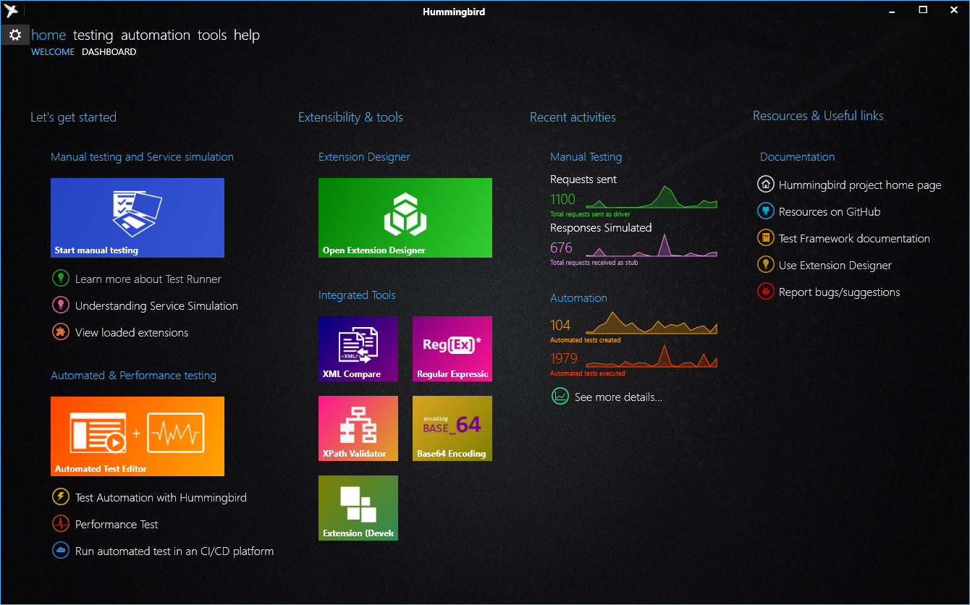
Hummingbird APP
The main application with graphical user interface, to do all the things with
Test any kind of web services, including SOAP, REST and Non-HTTP services by extension
Simulate services that your system depends on
Build and run automated tests
Build and run service performance tests
View usage statistics
Import service description from WSDL and OpenAPI / Swagger 2.0

Slide 6
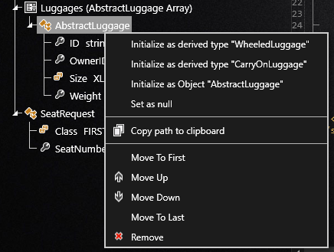
API Testing features : Object-model Based test editor
Services are organized and categorized
Object Model based test editor
Uses advanced programming technology to generate test data based on Object models
Hides technical complexity of service protocols
Schema recognition, Value type detection and validation
Test data is represented in its best way
Syntax highlighting
Document Folding
Schema based error checking
Variables and Test Environment management
Manages variables, credentials and parameters for each test environments
Example of schema recognition

Slide 7
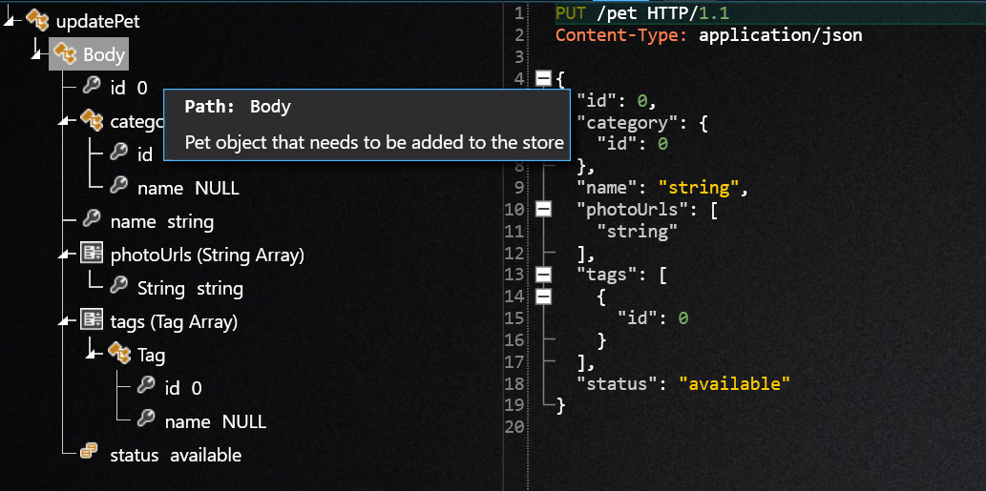
API Testing features - suite
Live Help *
Recognizes OpenAPI documentation and show them lively during the test
Helps better understanding the “functional meaning” of a structure
Live XPath Generation
Generate XPath from anywhere of the document
* Available for services defined by OpenAPI (Swagger)

Slide 8
API Testing features
Simplicity
Makes API Testing available for everyone, no technical background required.
Productivity
Using advanced technologies to guide user run tests faster.
Seamlessly
Object-model approaches works seamlessly for all type of API protocols and gives a consistent experience to test any kind of Web Service.

Slide 9
Real-time service simulation
Hummingbird can also simulate underlying services of your application.
With service simulation, you can set the reply of each underlying service in real-time in order to:
Simulate a normal or abnormal response
Simulate an error or a fault *
Simulate response time
Service simulation module is also available for test automation.
* Fault replies defined in SOAP protocol

Slide 10
Test Automation
Hummingbird comes with an powerful automation engine.
That enables you to build automated test, run them and observe the test result in a graphical way.
Automated tests can also be executed with Hummingbird CLI and can be integrated with your favorite CI/CD platform.

Slide 11
Service performance test
Performance test is perfectly integrated within an automation project
It can be run from command-line
Or in a CI/CD pipeline
Test configuration in real-time
Several built-in test models are provided
Load test
Stress test
Spike test
Or, your own performance test model

Slide 12
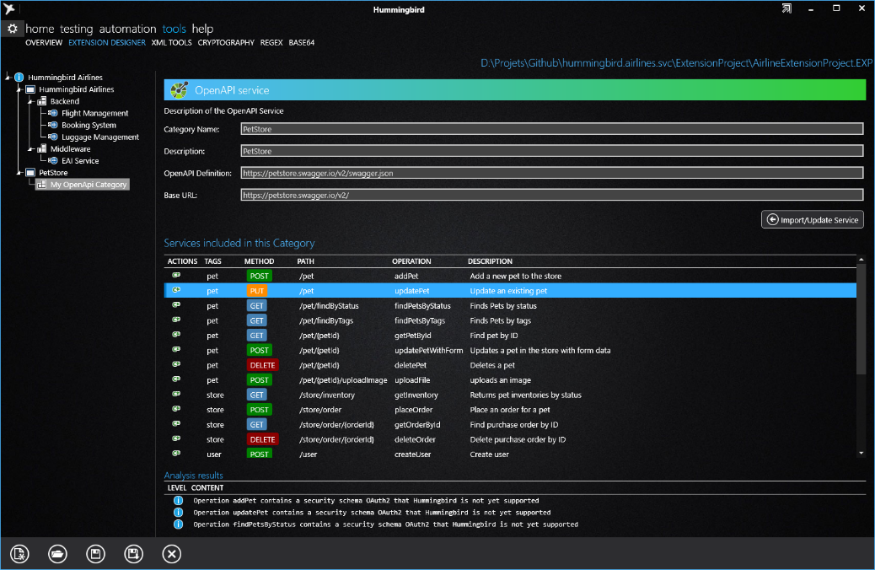
Extension Designer
With Extension Designer, you can import service descriptions from WSDL and OpenAPI (Swagger).
Service descriptions can then be compiled, packaged and loaded in Hummingbird quickly. Also these services description are versioned and shared.

Slide 13


Extensibility
Extensions can also be developed on top of Hummingbird Test Framework
Import your own API’s with your own style
Implement protocols used in your system and integrate them with Hummingbird
Improve the user experience by developing the proper data viewer
On our GitHub repository, you can find these examples
SMS-C Simulator
Service simulation of protocol EMI/UCP used by telecom operators
This protocol is used to connect information system with SMS-Center over TCP
This simulator is used in test environment to avoid sent Text Messages to the real terminal
LDAP Client
Service implementation to query Active Directory
This client can be used to integrate tests with enterprise directory based information system.

Slide 14
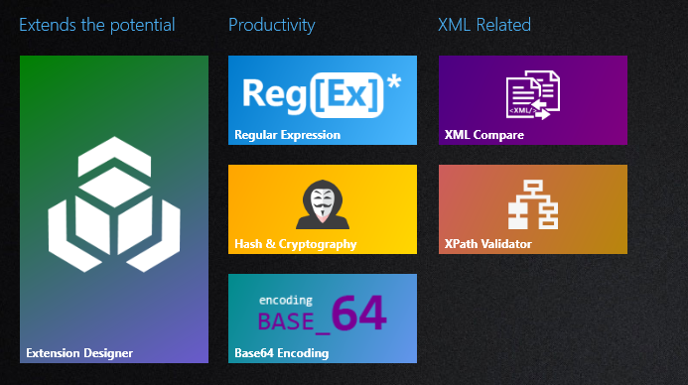
Integrated tools
Integrated tools are here to help developers and testers to run daily tasks within the software:
Regular Expression Tool
XML Compare
XPath Validator
Base 64
Hash and Cryptography
Integrated tool are also extensible !

Slide 15
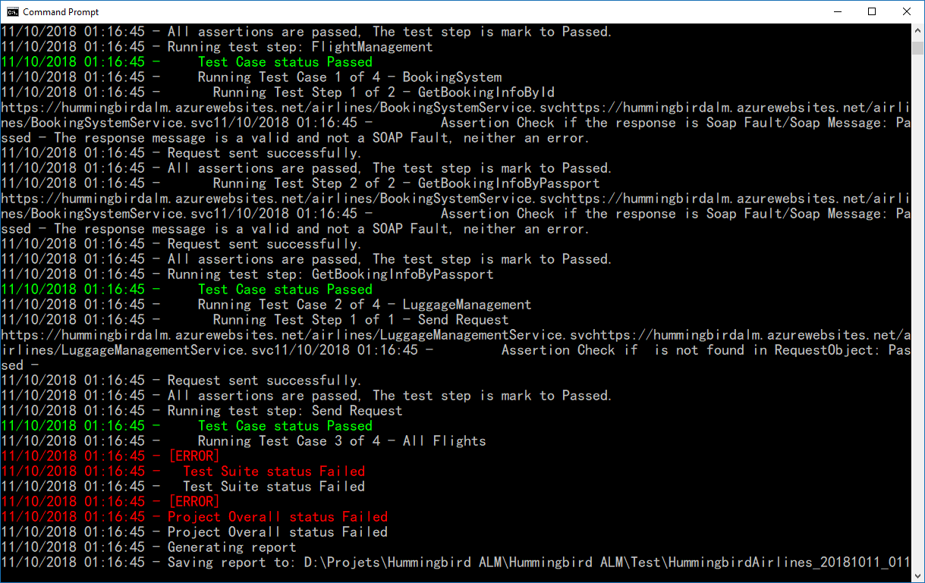


Continues integration / Continues deployment
Commit
Build
Test
Deploy
Run automated tests within your continues integration pipeline.
Show test results directly in your favorite CI/CD platform such as:
Using Hummingbird CLI, integrated to other platforms are also possible
Azure DevOps

Slide 16
Resources
Useful links
For Developers
Project home page
http://www.hummingbird-alm.com
Online Help
https://huaxing-yuan.github.io/hummingbird.doc
Demo Soap services
https://hummingbirdalm.azurewebsites.net/airlines/
Test Framework SDK
NuGet package
Online Documentation
Modern UI Framework
NuGet package
Online Documentation
Extensions
SMS-C Simulation source code
LDAP Client source code

